Slide 1

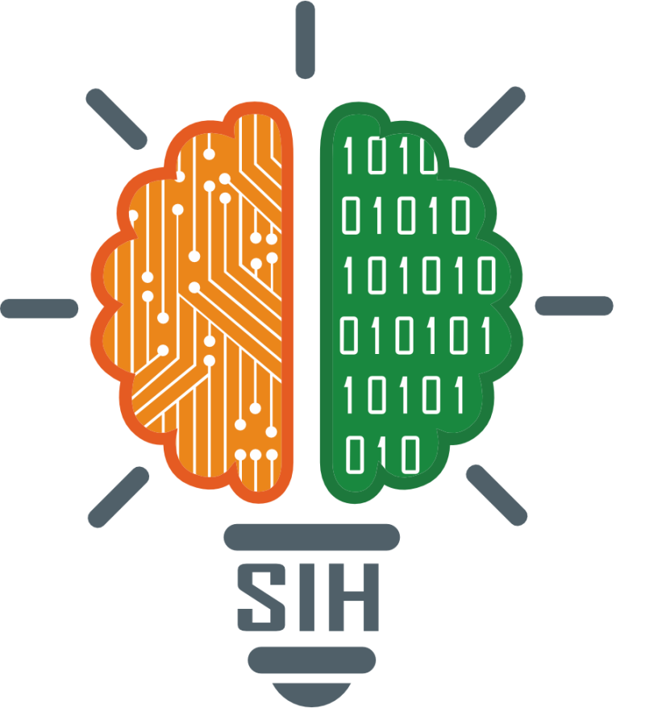
SMART INDIA HACKATHON 2025
Empowering rural and semi-urban communities with real-time health guidance and alerts
Problem Statement ID – 25049
Problem Statement Title- AI-Driven Public Health Chatbot for Disease Awareness
Theme- MedTech/BioTech/Healthtech
PS Category- Software
Team ID-
Team Name- Falcon

Slide 2
FALCONCARE Multilingual AI-Driven Public Health Chatbot
FALCON
The Problem:
Rural areas lack accurate, timely healthcare info
Barriers: language, internet access, awareness.
Our Solution – FalconCare:
AI chatbot for symptoms, prevention, vaccination.
Multilingual: Hindi, English, regional languages.
Accessible via WhatsApp & SMS (no apps needed).
Real-time alerts from govt. health databases.
Innovation & Uniqueness:
Rural-first chatbot, low bandwidth optimized.
Trusted data (govt.-verified, not generic).
Preventive healthcare focus (awareness > treatment).
Scalable nationwide.
Expected Impact:
20% rise in health awareness.
Reach millions via SMS/WhatsApp.
Build trustworthy health infrastructure.

Slide 3
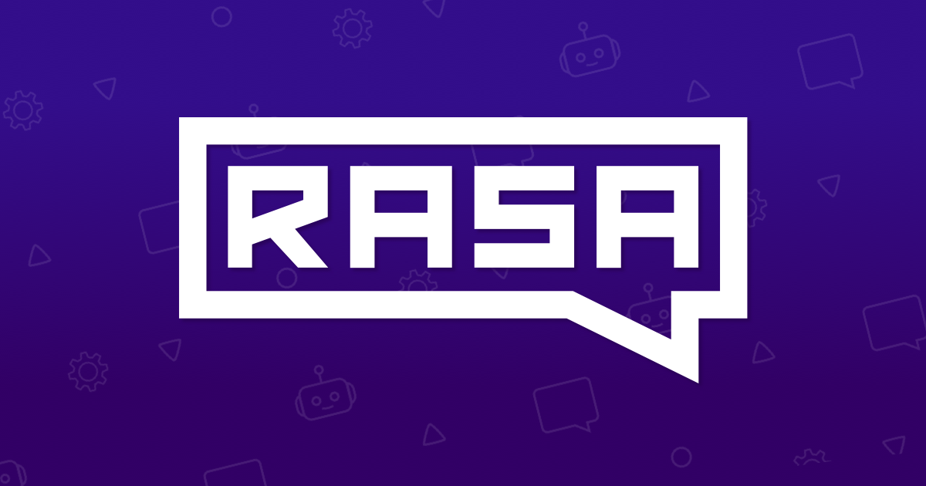





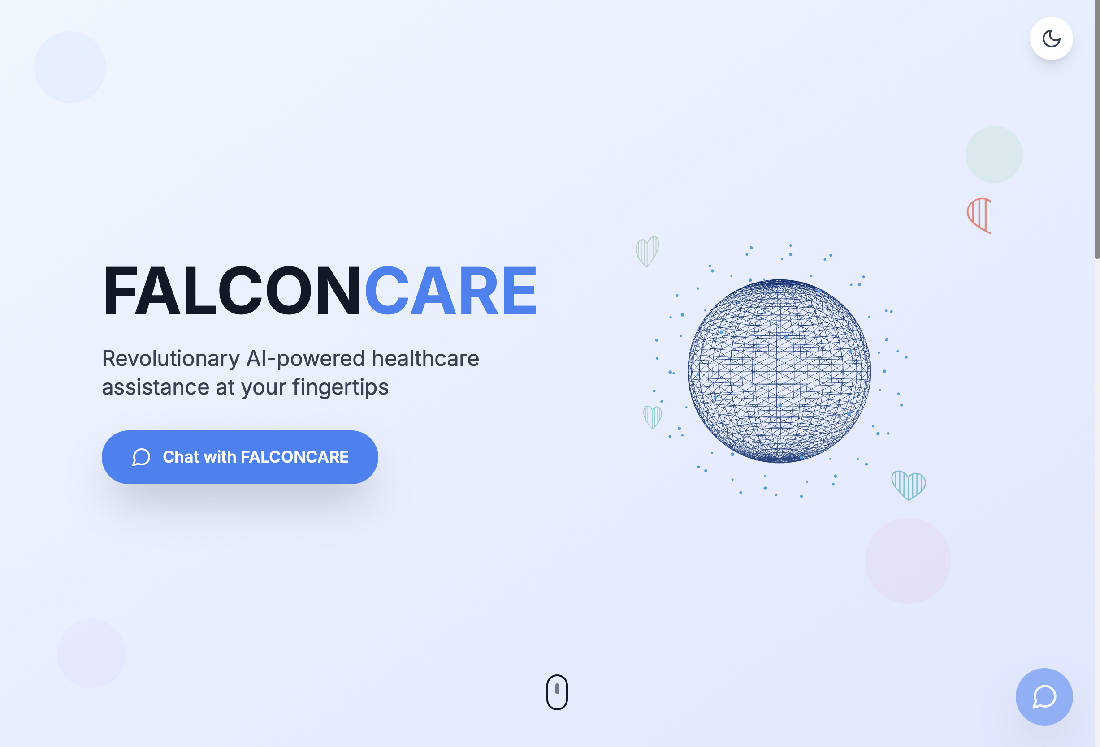
FALCONCARE
FALCON
Tech Stack & Approach
NLP Engine: Rasa (intent recognition, dialogue mgmt).
Multilingual Support: Hindi, English + regional languages.
Integration: APIs for govt. health databases (alerts, vaccination).
Channels: WhatsApp & SMS (via Twilio / Meta APIs).
Deployment: Docker + Cloud (AWS/Azure/GCP).
Testing: Pytest with ≥80% code coverage.
Process Flow
1️⃣ User sends query →
2️⃣ Rasa identifies intent →
3️⃣ Fetch info from DB/API →
4️⃣ Respond in user’s language (SMS/WhatsApp/web).
Prototype(Working Build)

Slide 4
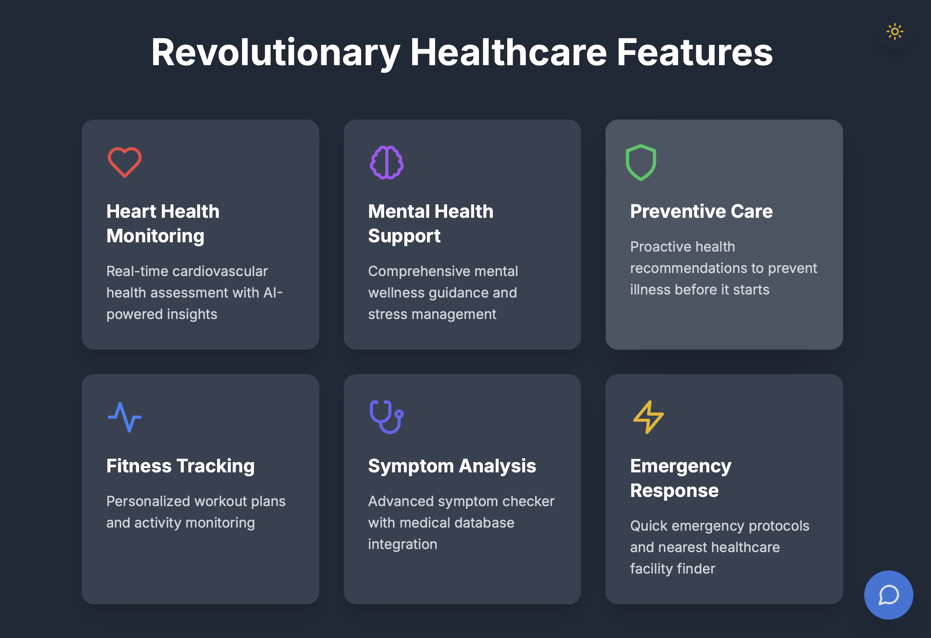
FALCONCARE
FALCON
Feasibility:
Uses mature NLP frameworks (Rasa/Dialogflow)
Health data APIs available (Govt/WHO)
Deployable on cloud (AWS/GCP/Railway)
Accessible via WhatsApp & SMS
Multilingual support achievable
Potential Challenges:
Users may not understand technical terms
Language diversity (regional languages)
Connectivity issues in rural areas
Strategies to Overcome:
Use simple, friendly, easy-to-understand language
Start with English + Hindi; add regional languages gradually
Support SMS for low connectivity areas
Use verified health data and fallback responses for errors

Slide 5
FALCONCARE
FALCON
Impact & Benefits
Potential Impact on Target Audience:
Educates rural & semi-urban populations about disease prevention and vaccination
Provides real-time outbreak alerts to keep communities safe
Increases health awareness and reduces misinformation
Empowers people to make informed health decisions
Benefits of the Solution:
Social: Safer communities, healthier families, better awareness
Economic: Reduces unnecessary healthcare costs by early prevention
Environmental: Encourages hygiene & disease prevention practices
Technological: Demonstrates AI, NLP, and multilingual communication for public good

Slide 6
FALCONCARE
FALCON
Reference Research Work
1.⁠ ⁠Multilingual Healthcare Chatbots
AI chatbots for rural healthcare, symptom diagnosis, and multilingual support.
ResearchGate Paper: https://www.researchgate.net/publication/352668726_Multilingual_Healthcare_Chatbot_Using_Machine_Learning
2.⁠ ⁠AI Chatbots for Health Behavior Change
Systematic review on AI chatbots promoting health awareness and personalized interventions.
PMC Study: https://pmc.ncbi.nlm.nih.gov/articles/PMC10007007
3.⁠ ⁠AI & Telemedicine in Rural Healthcare
Explores AI to improve healthcare delivery in underserved communities.
PMC Article:https://pmc.ncbi.nlm.nih.gov/articles/PMC11816903/
4.⁠ ⁠AI Chatbots in Public Health Emergencies
Role of chatbots in disseminating info and guiding public health responses.
MDPI Review: https://www.mdpi.com/1999-5903/17/4/145
5.⁠ ⁠Jugalbandi Chatbot (Real-World Example)
AI chatbot helping rural citizens access government services in multiple languages; aligns with our theme of public health awareness.
Microsoft News: https://news.microsoft.com/source/asia/features/with-help-from-next-generation-ai-indian-villagers-gain-easier-access-to-government-services/

